Slide 1
Capital Iron
Skye Spaulding, Bayden Woodland, Pasha Bolokhov and Ian Snider

Slide 2
Background
Capital Iron is a Victoria based store
They carry a large variety of products including:
Clothing
Camping gear
Kitchen Wares
Tools
Furniture

Slide 3
Value Proposition
An alternative to stores like Walmart
Sells almost everything people need
A local store

Slide 4
Customer Segment
They work on creating brand loyalty
Most of their customers are older or have families
They keep their customers through good service

Slide 5
Marketing
They rely on word of mouth to advertise
They send out their flyers in the newspaper
They sponsor some charity events
Their flyers are very graphically heavy

Slide 6
Stock
They carry a large selection of items
Their stock shifts with popularity
They don’t currently carry many electronics

Slide 7
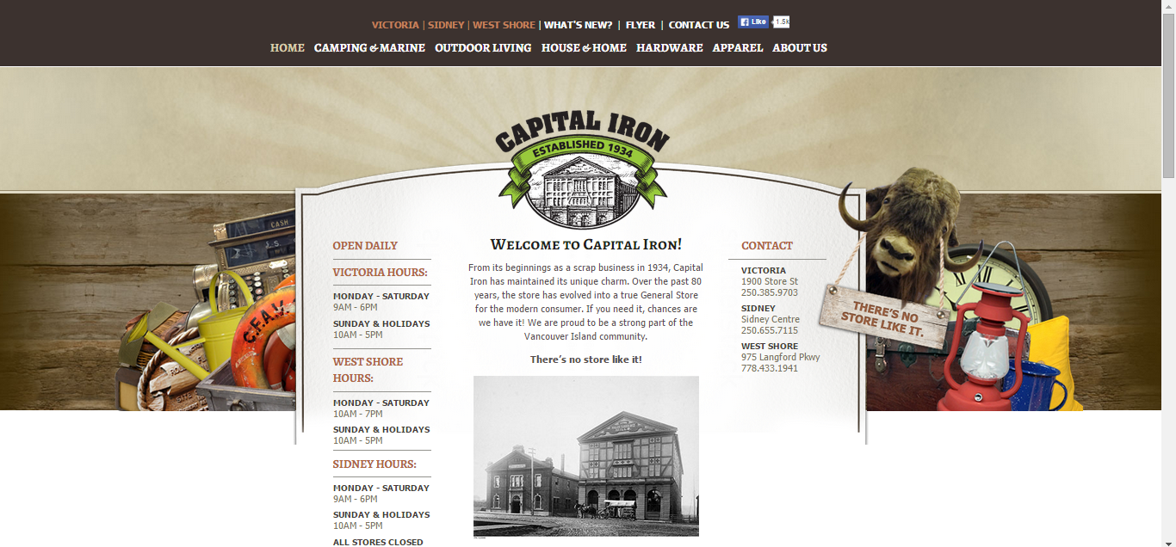
Online Presence (Current)

Slide 8
Online Presence (overview)
Follow the modern trends in web-site organization
Mobile compatibility
Should be based on customers’ most frequent needs
Include large (complete) background images
Historical overview should be lower priority
Historical theme would be more appropriate

Slide 9
Online Presence (Site Content)
Information about specific products should be included
Should include images, price, specifications,customer reviews
Accurate quantity information
Departments should be organized into a tree, which should be very easy (in fact trivial) to navigate
Online catalogues and flyers
Combine historical style with modern web site architecture

Slide 10
Scope (Current)
Only lower Vancouver Island is covered
The type of goods make sense for smaller communities
The spirit of the store matches the general identity of the communities of Vancouver Island and the Gulf Islands

Slide 11
Scope (Opening a new Branch)
Nanaimo is a perfect place to open a new store
Communities like Qualicum Beach, Parksville, Ladysmith, Duncan, Port Alberni are within reach
There is a huge flow of traffic through Nanaimo
Nanaimo is also en route to popular sports and outdoor destinations
Costs of opening a branch are high, but lower than Greater Victoria
The returns are expected to be high

